Slide 1
RECOGNITION SYSTEMS
Practice Labs
Prof. Farid Melgani
Dott. Riccardo Ricci

Slide 2
What I want to cover in the labs
Introduction
Python and Pytorch
SSH connection for training
Labs topics
Binary classification
Multiclass classification
Multilabel classification
Image captioning
Sentiment classification

Slide 3


Introduction
General purpose language
Interpreted
Very user friendly (sometimes too much)
Useful for rapid development of ideas
Ideal for building and testing neural networks
Framework for data science (computer vision, natural language processing and so on)
Originally developed by META AI
Very user-friendly when it comes to build neural networks

Slide 4
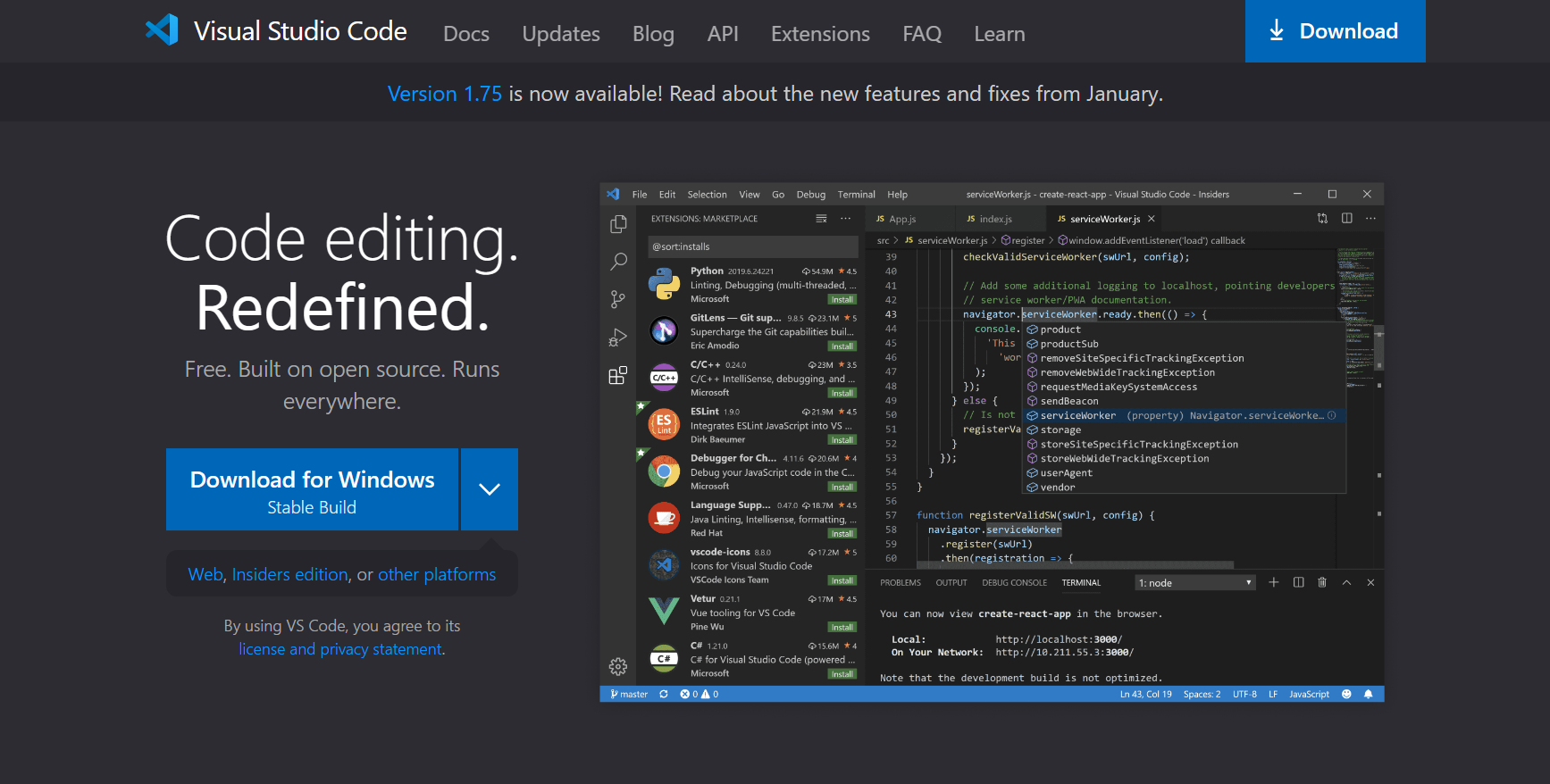
SSH connection
Steps
1) Download Visual Studio Code Visual Studio Code - Code Editing. Redefined

Slide 5
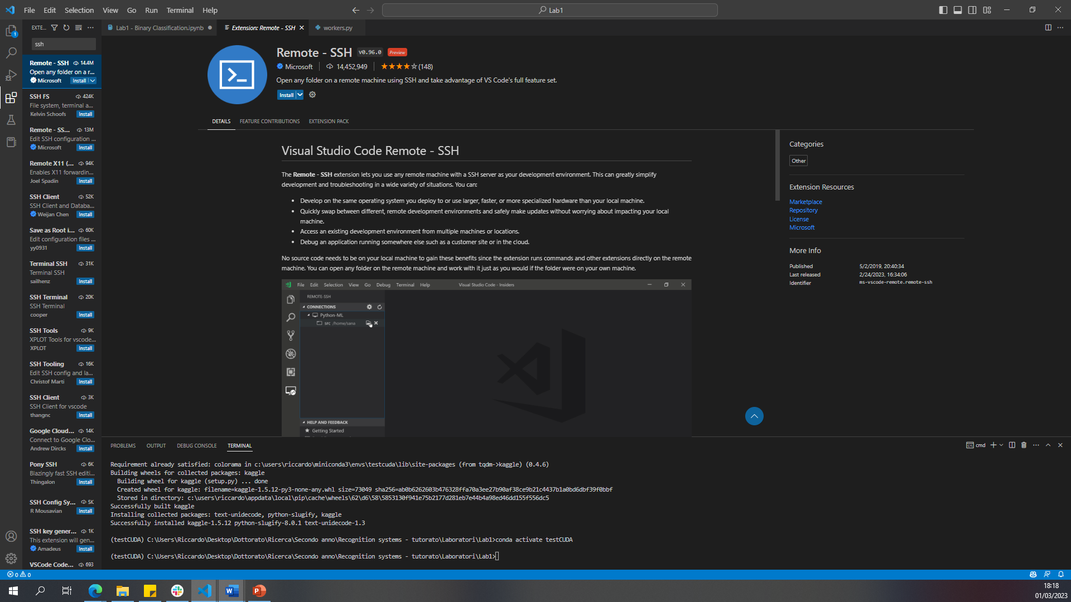
SSH connection
2) Download the SSH plugin
Search for “ssh”
Pick “Remote – SSH” from Microsoft
Click install
Click on “extensions”

Slide 6
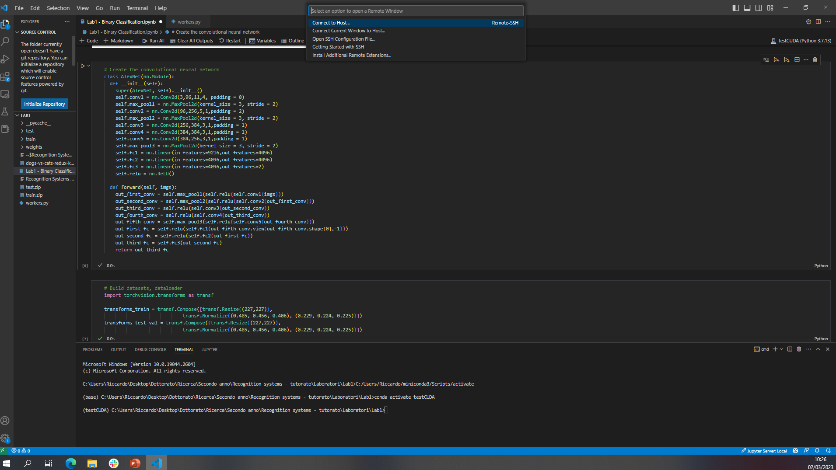
SSH connection
3) Connect to the workstation using SSH plugin
Select “connect to host”
Click on the green icon

Slide 7
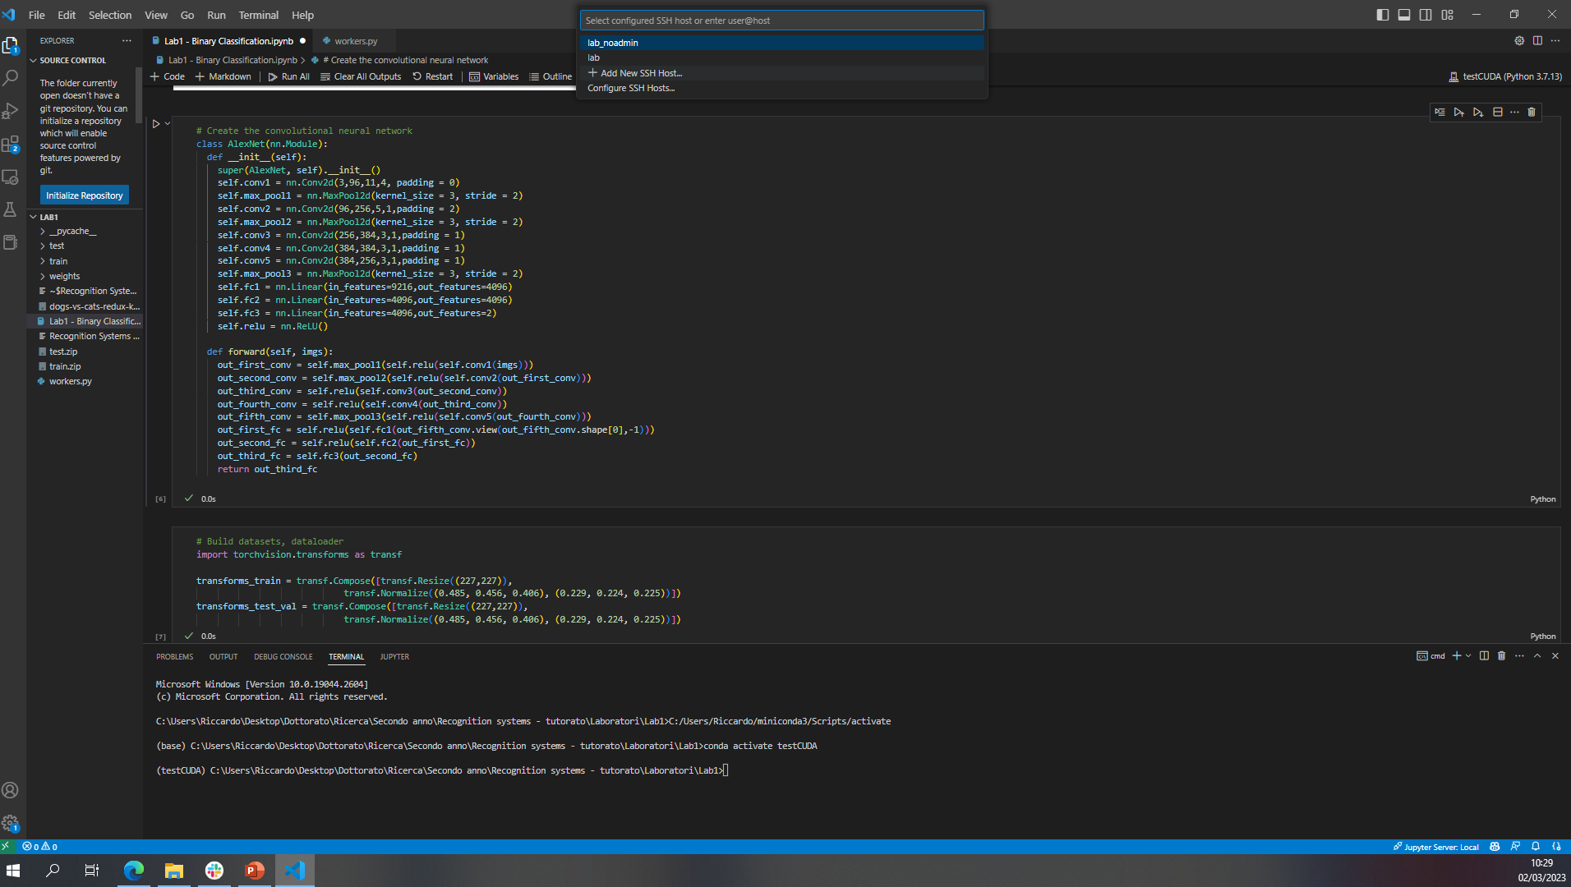
SSH connection
Select “add new ssh host”

Slide 8
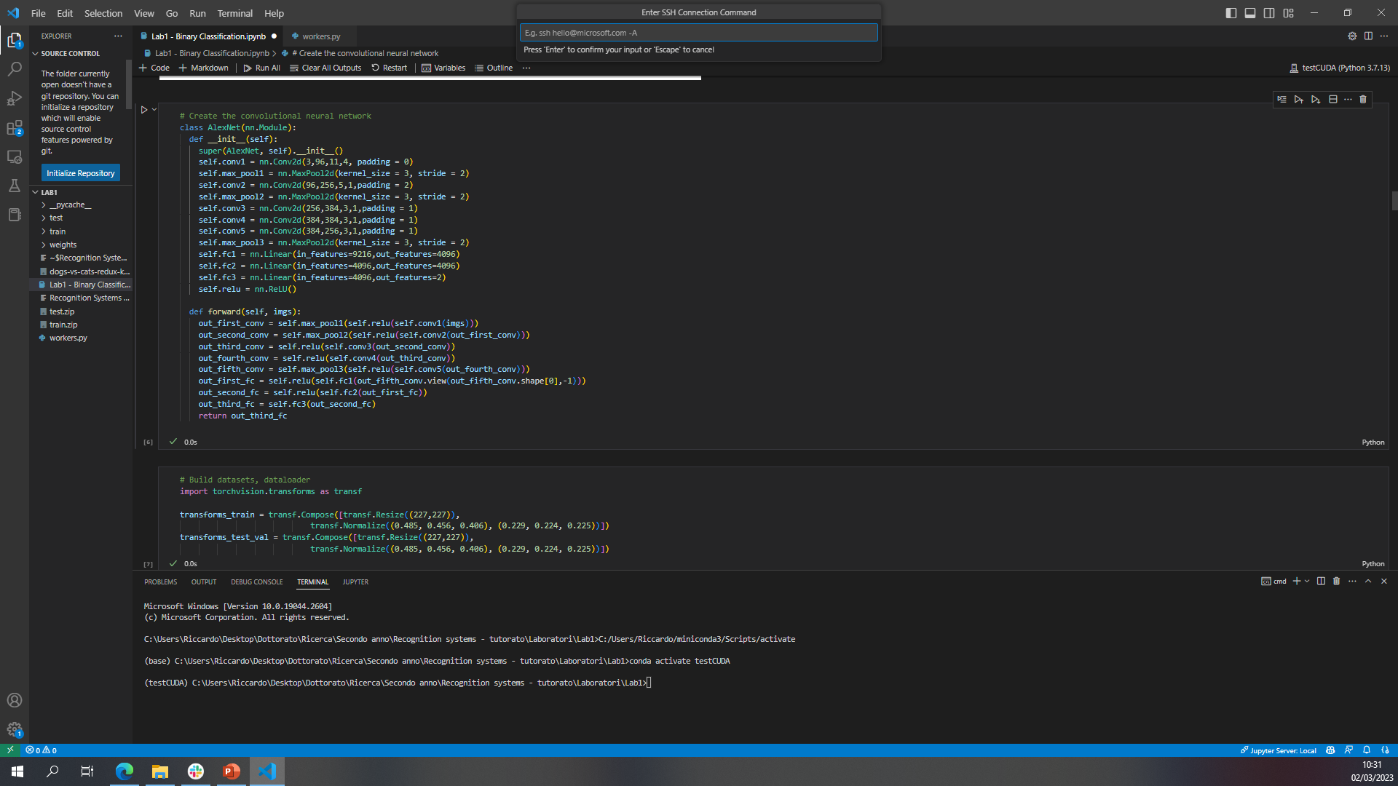
SSH connection
write “ssh guest_user@10.196.36.127” and click enter, then it will pop another VS code window and you will be connected to the workstation!

Slide 9
Navigate to the folder
For each Lab, I will prepare a folder under the path :
C:\Users\guest_user\Labs\Lab x (where x will be 1,2,3 and so on)
Just select “open folder” and navigate to this path, then click ok

Slide 10
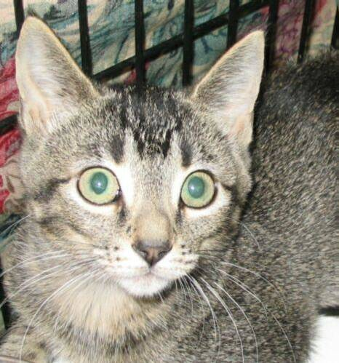
Lab topics
Binary classification
NEURAL NETWORK
It is a cat!
Input
Output

Slide 11

Lab topics
Multiclass classification
0
1
2
3
NEURAL NETWORK
4
5
6
7
Input
8
9
Output

Slide 12
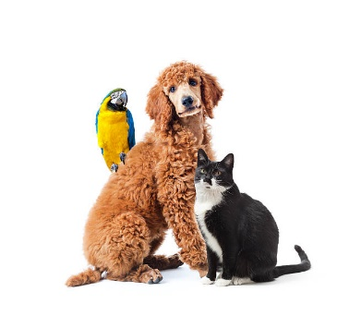
Lab topics
Multilabel classification
dog
elephant
giraffe
zebra
NEURAL NETWORK
parrot
cat
mouse
fox
Input
wolf
dolphin
Output

Slide 13
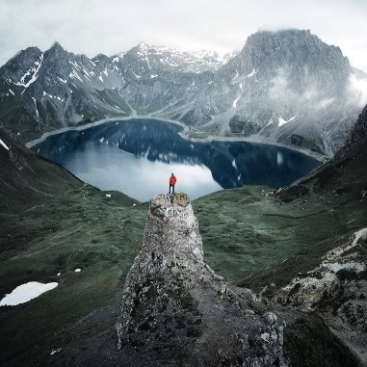
Image captioning
NEURAL NETWORK
A mountain landscape, with a lake in the background and a person on top of a pinnacle
Input
Output

Slide 14
Sentiment classification
Today it is sunny outside! So excited for the day to come!
NEURAL NETWORK
Positive
Neutral
Negative
Input
Output

Slide 15
Many others possibilities..
Object detection
Segmentation
Image super resolution
Ecc ecc

Slide 16
Binary Classification
Binary classification: Classification of samples into two groups.
NEURAL NETWORK
It is a cat!
Input
Output
Open the SSH connection and go to the folder …..
Genc Hoxha
Lab session 1

Slide 17
Convolutional neural network
Introduced by Yann LeCun in 1989.
One of the most used architectures in deep learning, especially when dealing with images, even tough they can be used for any data that has a fixed grid like structure (e.g. time series data).
Mettere immagine

Slide 18
CNN
These networks inherit their name from a special kind of linear operation, the convolution.
As written in the book “Deep learning” by Goodfellow et al, CNNs are networks that “use convolution in place of general matrix multiplication in at least one of their layers”
Important properties of CNNs
sparse interactions
parameter sharing
equivariant representations

Slide 19
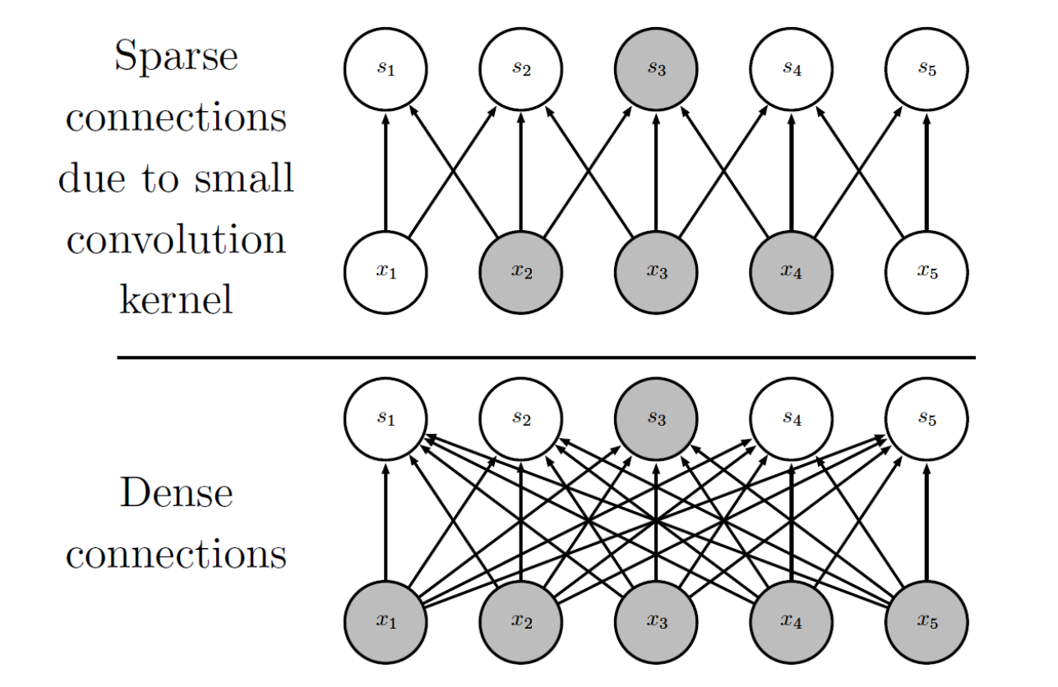
Sparse interactions
Image from “Deep Learning” by Goodfellow et al.

Slide 20
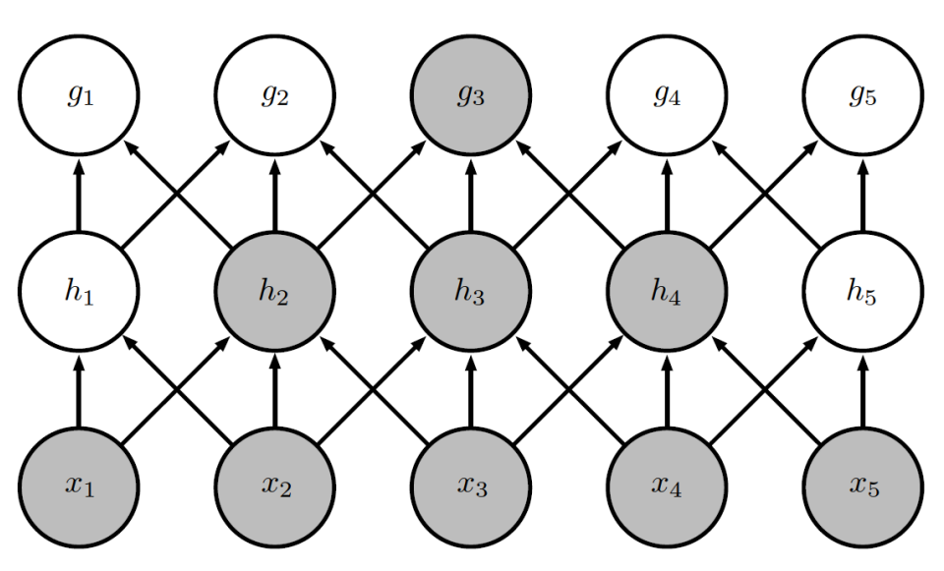
Receptive field
Image from “Deep Learning” by Goodfellow et al.

Slide 21
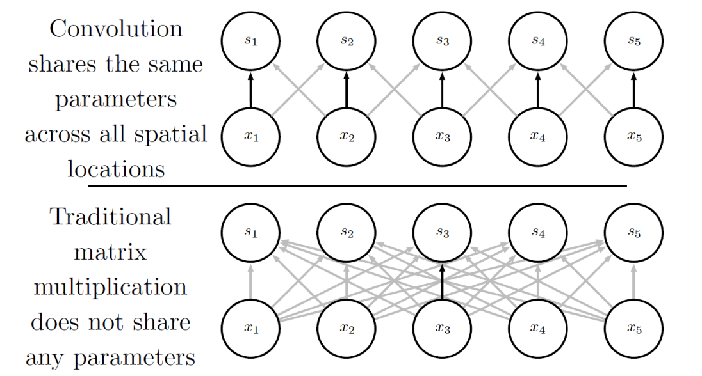
Parameter sharing
Image from “Deep Learning” by Goodfellow et al.

Slide 22
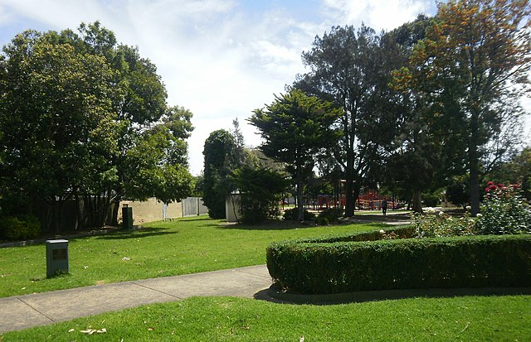
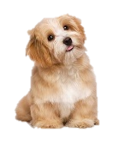
Equivariant representations
Parameter sharing causes a convolutional layer to be equivariant to translations in the input

Slide 23
CNN in practice
Main Ingredients
Convolutional layers
Activation functions
Pooling layers
Secondary ingredients
Fully connected layer (for classification)
Dropout layers
Batch normalization layers

Slide 24
Proposed network
We will try to implement a first simple CNN and try to classify input images into two categories: cats and dogs.
The network will have:
4 convolutional layers
4 pooling layers
2 fully connected layers
During testing we will experiment with concepts such as batch-normalization, dropout, weight-decay, various optimizers and so on.

Slide 25
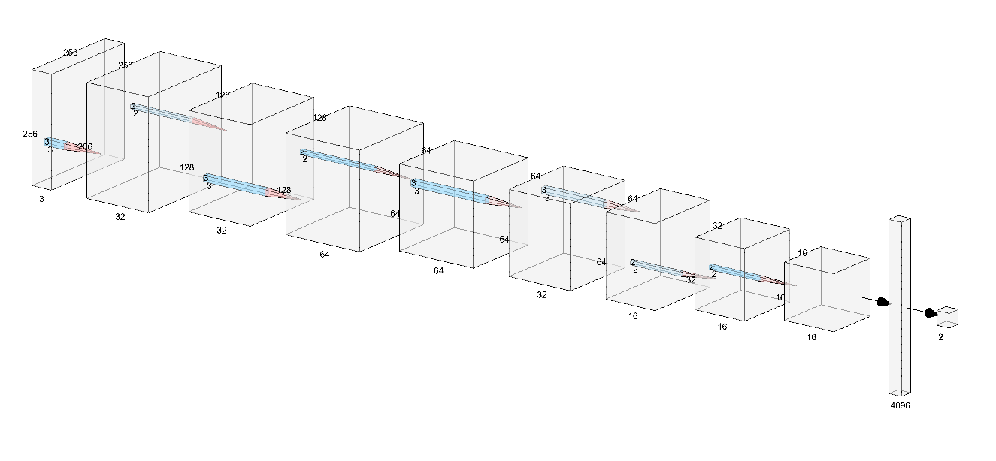
Proposed network: SimpleNet
Conv
Max pool
Conv
Max pool
Conv
Conv
Max pool
Adaptive avg pool
Linear
Illustration created with NN SVG (alexlenail.me)

Slide 26
Loss function
As a loss function, we will use CrossEntropyLoss
For the binary case, also the BinaryCrossEntropy (BCE loss) loss can be used, but their formulations lead to the same loss, even though BCE only requires one output neuron.

Slide 27
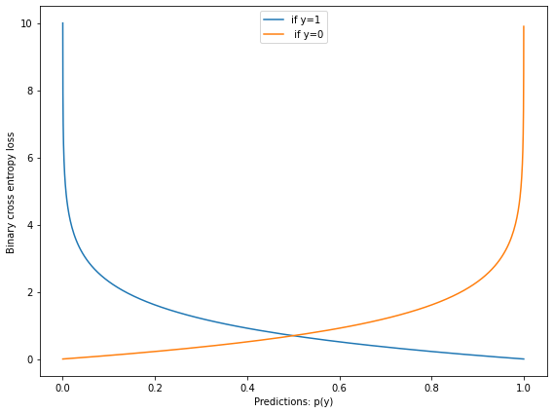
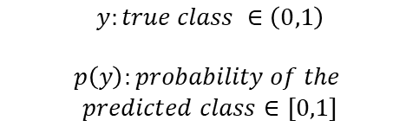
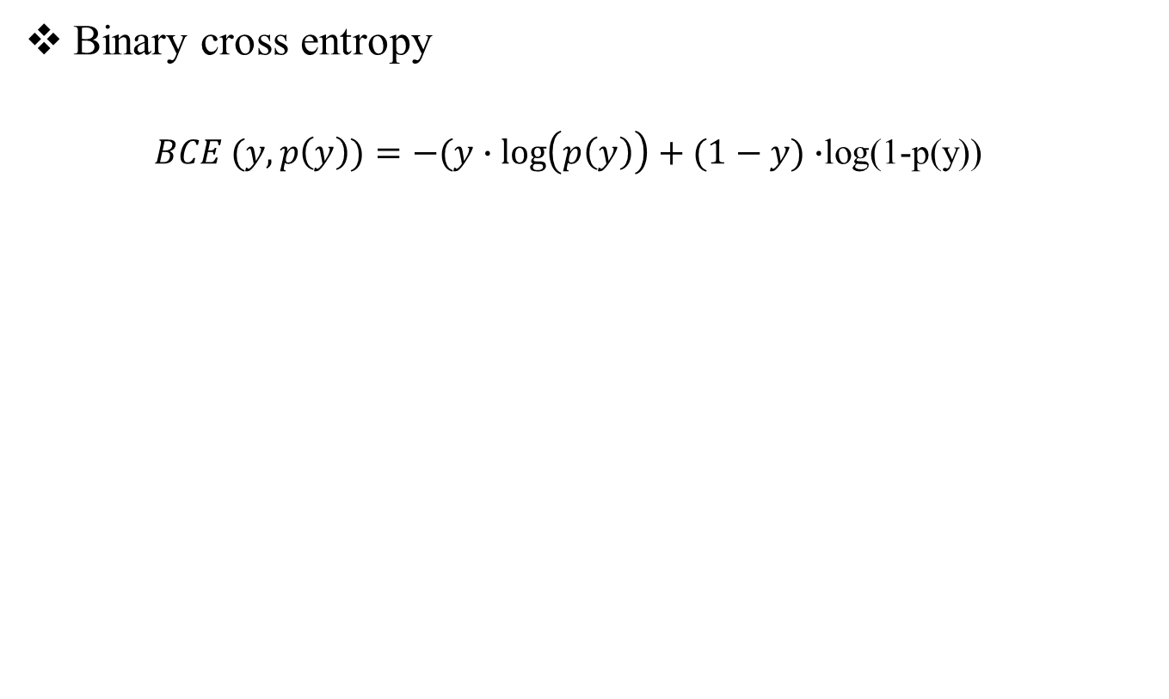
Loss Function
Binary cross entropy
$BCE (y,p\left(y\right))=−(y∙\log\left(p\left(y\right)\right)+(1−y)∙$log(1-p(y))
$$y:true class ∈\left(0,1\right)$$
$$p\left(y\right):probability of the$$
$$predicted class∈[0,1]$$
Genc Hoxha
Lab session 1
Notes:
Loss will be computed with respect to the true class (target) and predicted class.
The function punishes the wrong prediction, particularly the wrong predictions with higher confidence.
For instance, the blue line referrers to the situation where the true class is equal to one y=1. We can see that when the predicted class is 1, the loss equals to zero. Instead when the probability of the predicted class tends toward 0 the loss tends to infinite. Not only the loss tends to punish the wrong predictions, but it also tends to punish the wrong predictions which extremely confident.

Slide 28
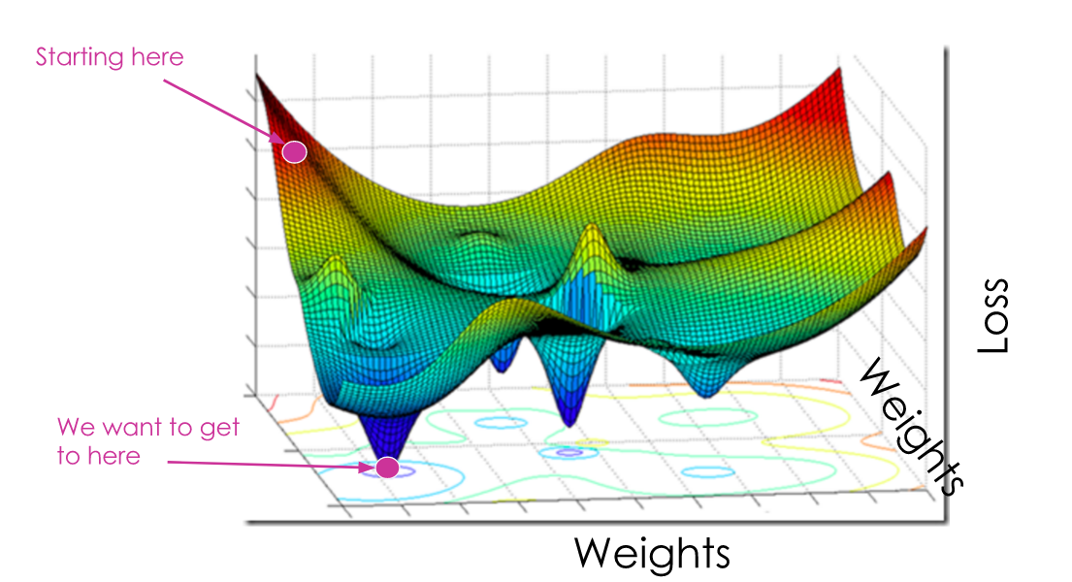
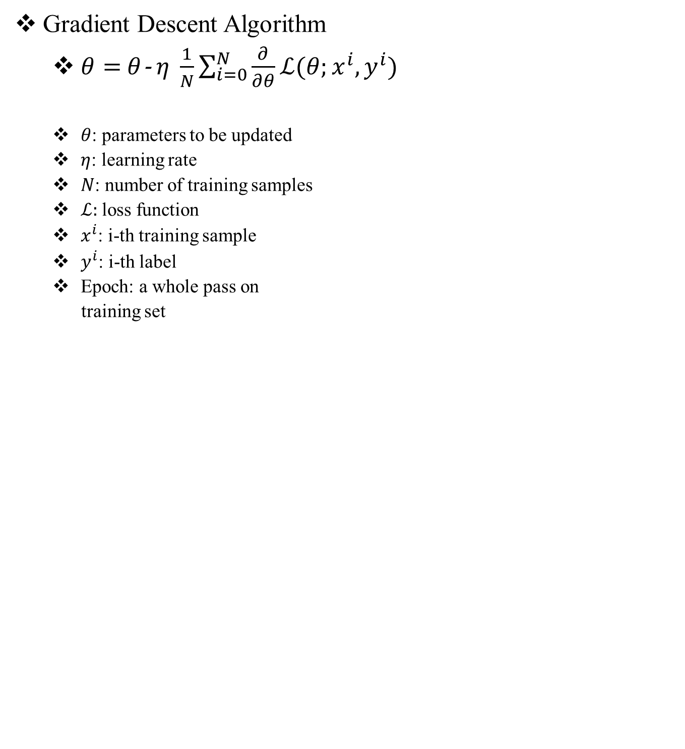
Optimizer
Gradient Descent Algorithm
$θ=$ $θ$-$η \frac{1}{N}\sum_{i=0}^{N}{\frac{∂}{∂θ}ℒ(θ;x^{i},y^{i})}$
$θ$: parameters to be updated
$η$: learning rate
$N$: number of training samples
$ℒ:$ loss function
$x^{i}$: i-th training sample
$y^{i}$: i-th label
Epoch: a whole pass on
training set
Genc Hoxha
Lab session 1
Notes:
If batch size= N : Stochastic Gradient Descent Algorithm (batch)
If batch size = 1: stochastic gradient descent: it will never converges as it evaluates the gradient for each training sample
If 1<batch size<N Stochastic Gradient Descent Algorithm (mini-batch)
Stochastic gradient algorithm: if done throughout the whole dataset it will take long, before updating the weights to make a small pass, we need to process the whole dataset, making it impractical as deep learning models needs a lot of data, hundred thousands and even millions.
Stochastic gradient algorithm computed on an minibatch. Minibatch is a subset of training set. We update the weights at each minibatch.
Learning rate determines how big is going to be our step towards the minimum of the loss function
Pros of minbatch sgd:
1) stable convergence compared to parameters update considering all the training samples at once or considering each training sample individually
2) very efficient and faster

Slide 29
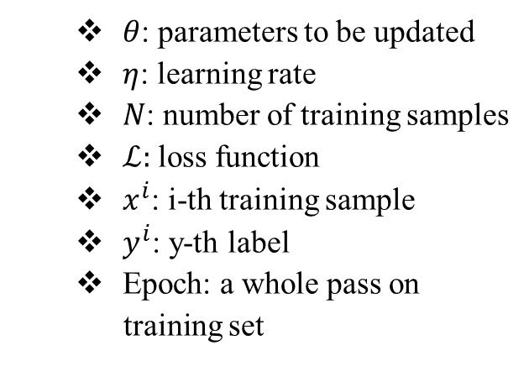
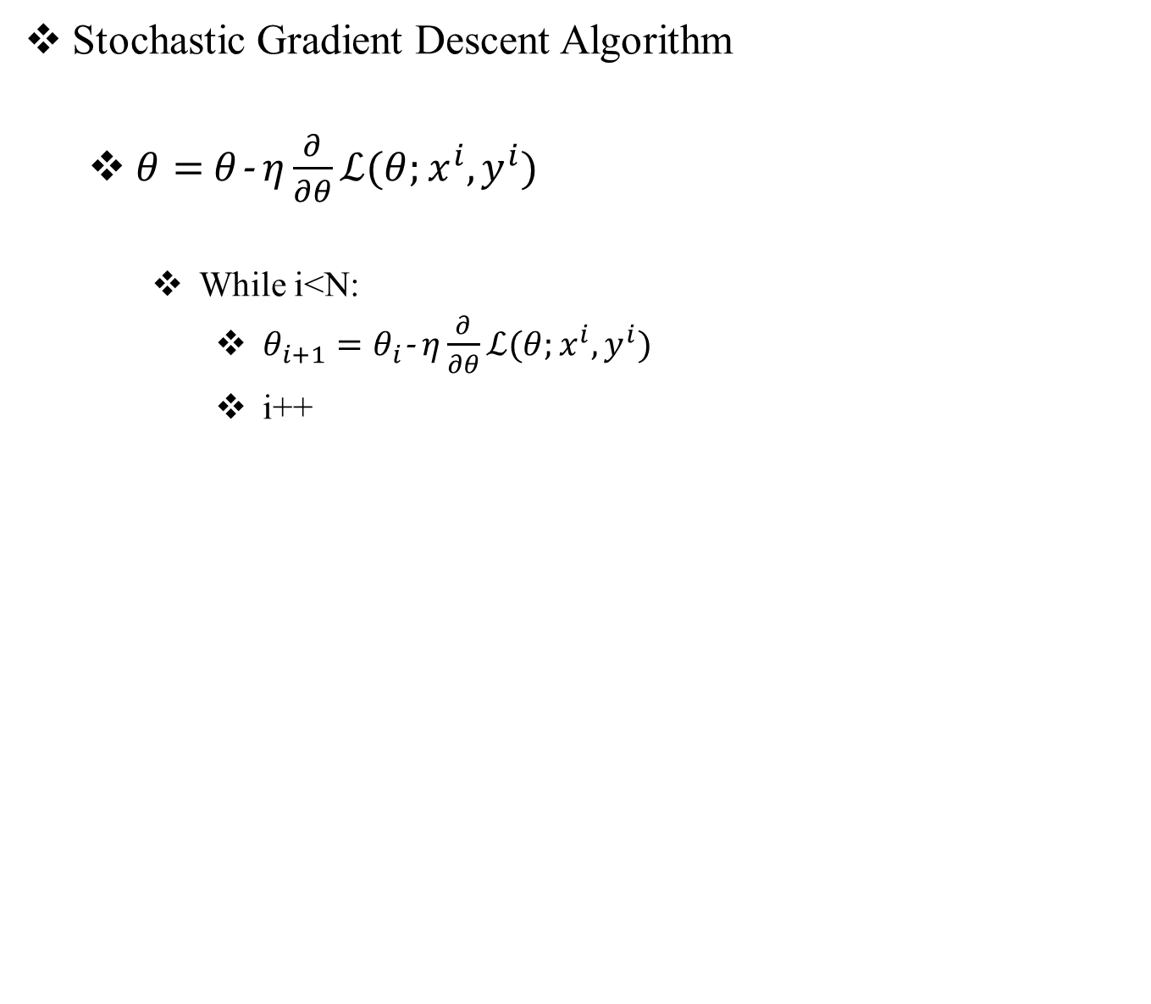
Optimizer
Stochastic Gradient Descent Algorithm
$θ=$ $θ$-$η\frac{∂}{∂θ}ℒ(θ;x^{i},y^{i})$
While i<N:
$θ_{i+1}=θ_{i}$-$η\frac{∂}{∂θ}ℒ(θ;x^{i},y^{i})$
i++
$θ$: parameters to be updated
$η$: learning rate
$N$: number of training samples
$ℒ:$ loss function
$x^{i}$: i-th training sample
$y^{i}$: y-th label
Epoch: a whole pass on
training set
Genc Hoxha
Lab session 1
Notes:
If batch size= N : Stochastic Gradient Descent Algorithm (batch)
If batch size = 1: Stochastic gradient descent: it will never converge as it evaluates the gradient for each training sample, it will be very random
If 1<batch size<N Stochastic Gradient Descent Algorithm (mini-batch)
Stochastic gradient algorithm: if done throughout the whole dataset it will take long, before updating the weights to make a small pass, we need to process the whole dataset, making it impractical as deep learning models needs a lot of data, hundred thousands and even millions.
Stochastic gradient algorithm computed on an minibatch. Minibatch is a subset of training set. We update the weights at each minibatch.
Learning rate determines how big is going to be our step towards the minimum of the loss function
Pros of minbatch sgd:
1) stable convergence compared to parameters update considering all the training samples at once or considering each training sample individually
2) very efficient faster

Slide 30
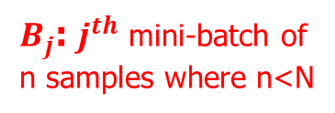
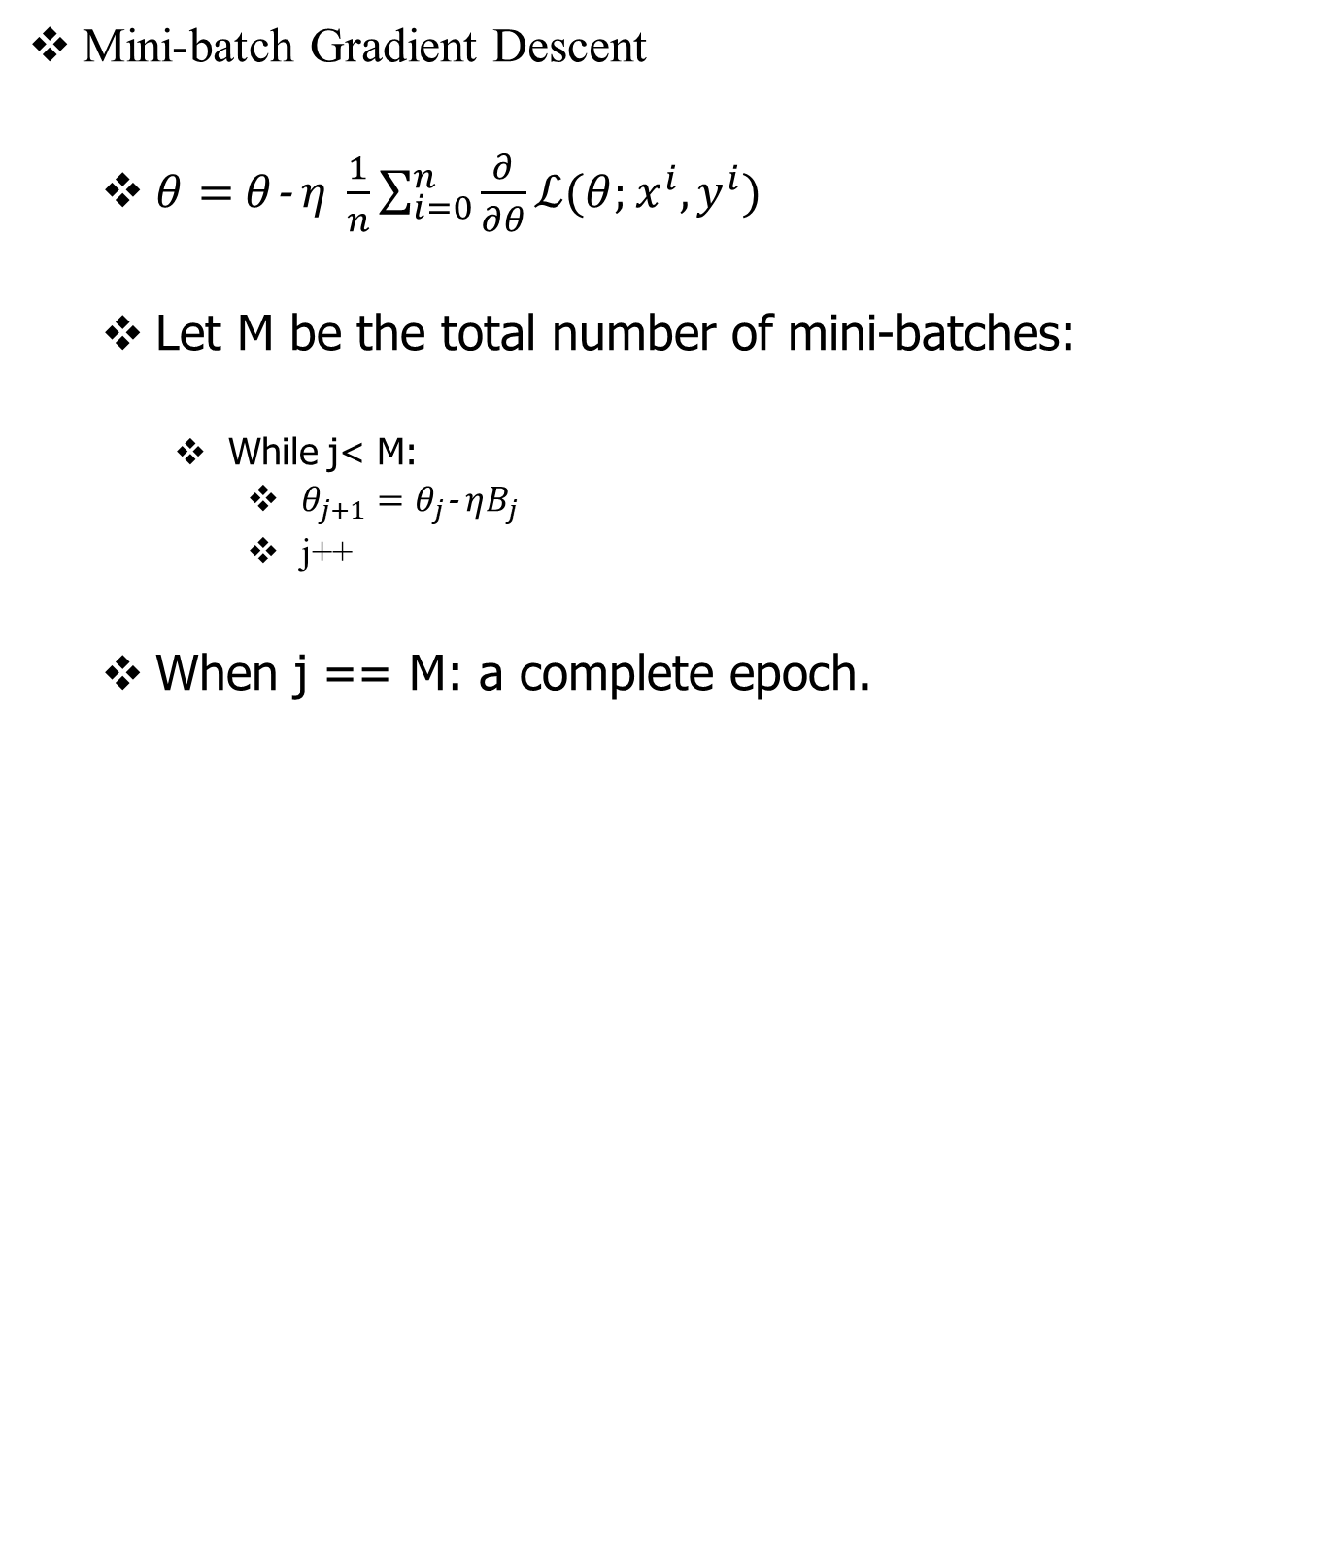
Optimizer
Mini-batch Gradient Descent
$θ=$ $θ$-$η \frac{1}{n}\sum_{i=0}^{n}{\frac{∂}{∂θ}ℒ(θ;x^{i},y^{i})}$
Let M be the total number of mini-batches:
While j< M:
$θ_{j+1}=θ_{j}$-$ηB_{j}$
j++
When j == M: a complete epoch.
$B_{j}$: $j^{th}$ mini-batch of
n samples where n<N
Genc Hoxha
Lab session 1
Notes:
If batch size= N : Stochastic Gradient Descent Algorithm (batch)
If batch size = 1: stochastic gradient descent: it will never converges as it evaluates the gradient for each training sample
If 1<batch size<N Stochastic Gradient Descent Algorithm (mini-batch)
Stochastic gradient algorithm computed on an minibatch. Minibatch is a subset of training set.
Learning rate determines how big is going to be our step towards the minimum of the loss function
If the minibatch is too small: we have noise, meaning that the selected samples of the minibatch might not be representative of the training set.
Pros of minbatch sgd:
1) stable convergence compared to parameters update considering all the training samples at once or considering each training sample individually
2) very efficient and very fast
Epoch: a pass through all the training set.
Tips:
1) if training set small we can use batch gradient descent ( less than 2000)
2) 32,64,128,256. it should be power of 2. Code run faster
3) make sure that it fits to the gpu
4) is an hyper parameter so we have to try

Slide 31
Optimizer
Gradient Descent
Stochastic Gradient Descent
Mini-batch Gradient Descent
*
Genc Hoxha
Lab session 1
Notes:
Contours of the cost functions we are trying to minimize
If batch size= N : Stochastic Gradient Descent Algorithm (batch)
it may take relatively low noise and large steps and goes to the minimum smoothly, but the problem is that it is very slow if we have millions of samples
If batch size = 1: stochastic gradient descent: it will never converges as it evaluates the gradient for each training sample
on every iteration we take the gradient descent on one sample, some times we are on the right directions, other instead we go to a completely wrong one if the one example happens to point you in the wrong direction. As it can be seen from the graph, can be extremely noisy, sometimes it points toward the right direction and other no. It is extremely noisy and will never convert.
If 1<batch size<N Stochastic Gradient Descent Algorithm (mini-batch) it does not mean that it is going to converges but it tends to be more concisely toward the direction of the minimum
Stochastic gradient algorithm computed on an minibatch. Minibatch is a subset of training set.
Learning rate determines how big is going to be our step towards the minimum of the loss function
If the minibatch is too small: we have noise, meaning that the selected samples of the minibatch might not be representative of the training set.
Pros of minbatch sgd:
1) stable convergence compared to parameters update considering all the training samples at once or considering each training sample individually
2) very efficient and very fast
Epoch: a pass through all the training set.
Tips:
1) if training set small we can use batch gradient descent ( less than 2000)
2) 32,64,128,256. it should be power of 2. Code run faster
3) make sure that mini-batch it fits to the gpu/cpu
4) is an hyper parameter so we have to try to figure out which one is better in reducing the loss funtion

Slide 32
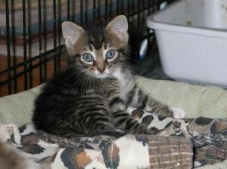
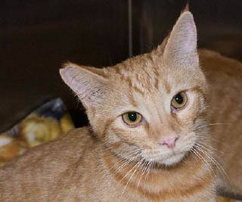
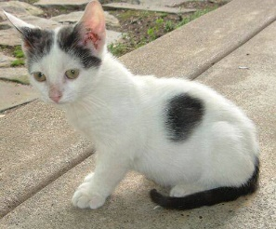
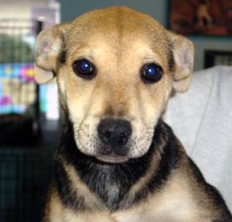
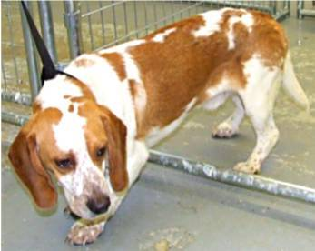
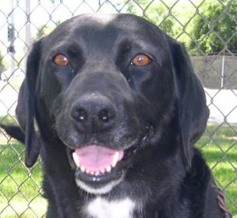
Dataset
Kaggle Dog VS Cat Dataset
Standard computer vision dataset
Training: 20.000 images (10.000 per class)
Validation: 5.000 images (2.500 per class)
Genc Hoxha
Lab session 1

Slide 33
Data Augmentation
Technique that artificially expands the dataset by creating modified versions of the images
Useful for generalization
Can also act as regularization term
Introducing noise into the dataset
Genc Hoxha
Lab session 1

Slide 34
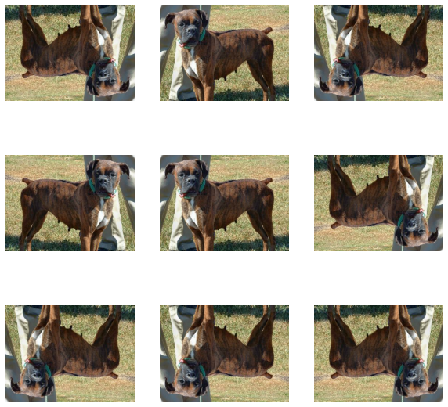
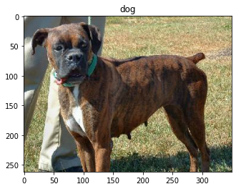
Data Augmentation
Horizontal and vertical random flipping
Genc Hoxha
Lab session 1

Slide 35
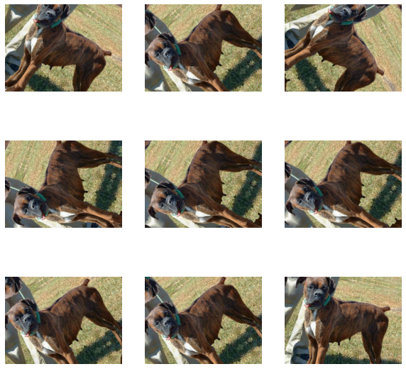
Data Augmentation
Random rotation
Genc Hoxha
Lab session 1

Slide 36
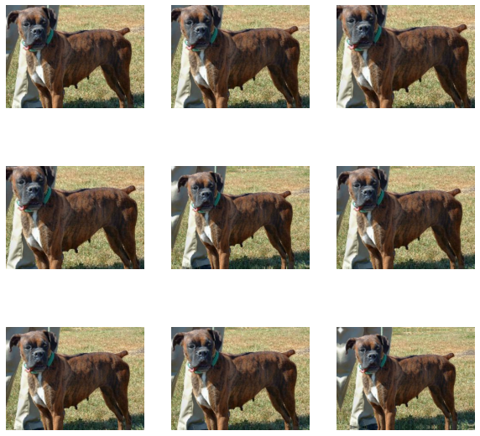
Data Augmentation
Random zoom
Genc Hoxha
Lab session 1

Slide 37
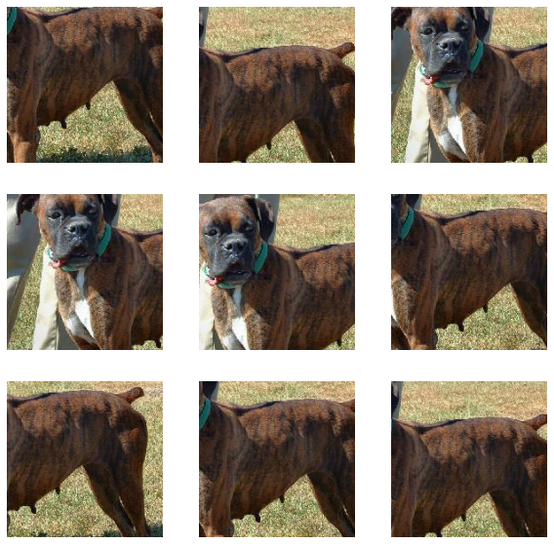
Data Augmentation
Random crop
Genc Hoxha
Lab session 1

Slide 38
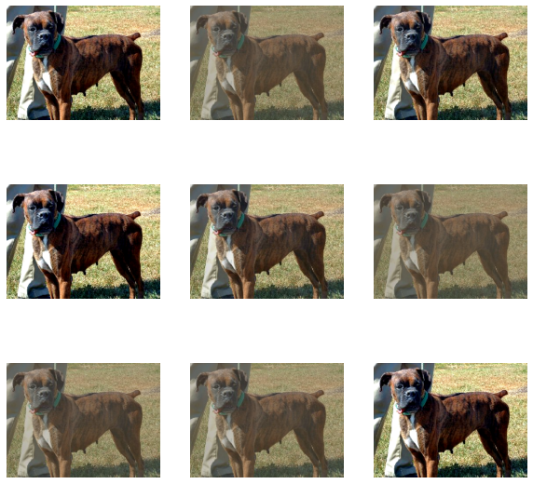
Data Augmentation
Random contrast
Genc Hoxha
Lab session 1

Slide 39
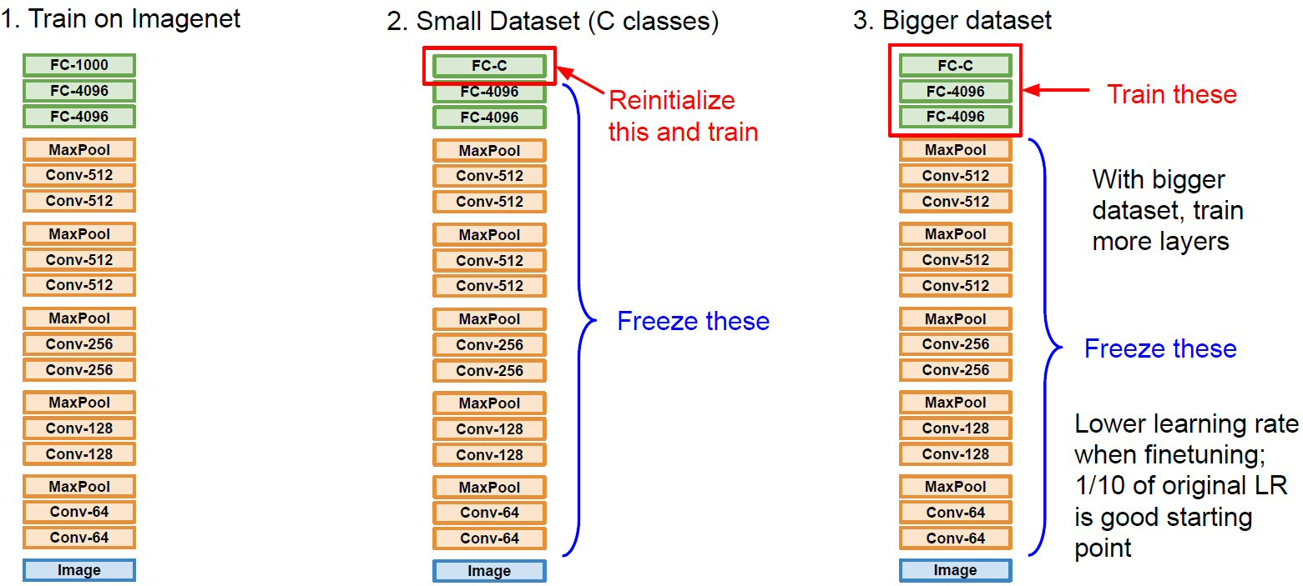
Transfer Learning
39
Genc Hoxha
Lab session 1
Notes:
Transfer learning: taking features learned on one problem and transfer them, or leverage these feature on similar problem.
It is typically done where your dataset is small to train a model from scratch.
The most common incarnation of transfer learning in the context of deep learning is the following workflow:
Take layers from a previously trained model.
Freeze them, so as to avoid destroying any of the information they contain during future training rounds.
Add some new, trainable layers on top of the frozen layers. They will learn to turn the old features into predictions on a new dataset.
Train the new layers on your dataset.
A last, optional step, is fine-tuning, which consists of unfreezing the entire model you obtained above (or part of it), and re-training it on the new data with a very low learning rate. This can potentially achieve meaningful improvements, by incrementally adapting the pertained features to the new data
a)This leads us to how a typical transfer learning workflow can be implemented in Keras:
Instantiate a base model and load pre-trained weights into it.
Freeze all layers in the base model by setting trainable = False.
Create a new model on top of the output of one (or several) layers from the base model.
Train your new model on your new dataset.
b)Note that an alternative, more lightweight workflow could also be:
Instantiate a base model and load pre-trained weights into it.
Run your new dataset through it and record the output of one (or several) layers from the base model. This is called feature extraction.
Use that output as input data for a new, smaller model
b)
pros: A key advantage of that second workflow is that you only run the base model once on your data, rather than once per epoch of training. So it's a lot faster & cheaper.
Cons An issue with that second workflow, though, is that it doesn't allow you to dynamically modify the input data of your new model during training, which is required when doing data augmentation, for instance.
Finally, let's unfreeze the base model and train the entire model end-to-end with a low learning rate.
Importantly, although the base model becomes trainable, it is still running in inference mode since we passed training=False when calling it when we built the model. This means that the batch normalization layers inside won't update their batch statistics. If they did, they would wreck havoc on the representations learned by the model so far.
We are going to use for transfer learning ResNet 50. Before explain ResNet 50 let us recap a plain CNN which is actually the type of the network that we will develop.

Slide 40
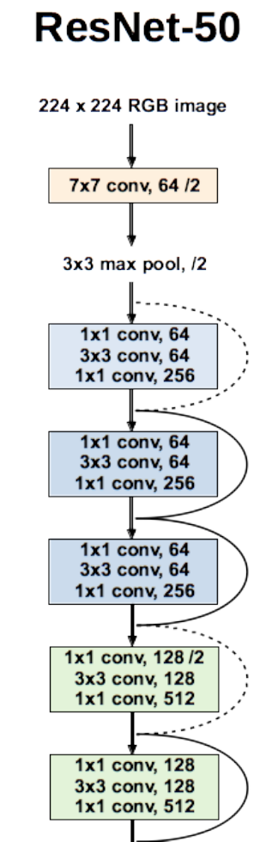
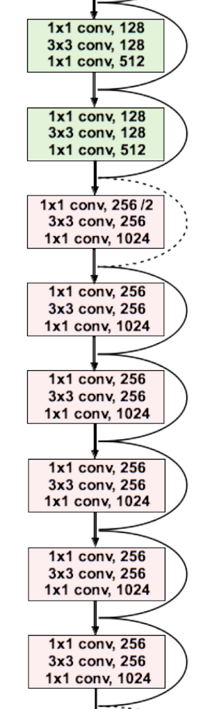
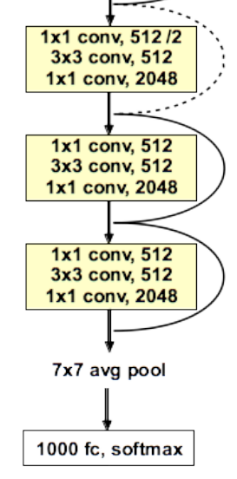
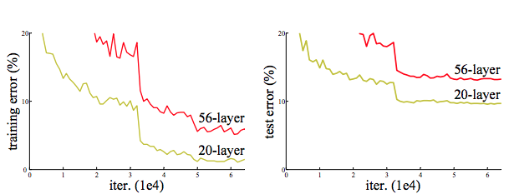
Plain CNN Architecture
40
Genc Hoxha
Lab session 1
Notes:
We expect in theory that the deeper the network the better the performance. But in reality this does not happen. Indeed, as it can be seen from the graph, adding more layer to a plain CNN network not only can not behave as the smaller counterpart but the accuracy depredates. And this is an unexpected behavior. Indeed Very deep neural networks are difficult to train because of vanishing and exploding gradient types of problems. Vanishing when gradient goes to zero and exploding when gradient becomes bigger and bigger. In a network of n layers for instance we going to have multiplication of derivatives (because of the chain rule ), if the derivatives are small than this is going to be vanishing gradients and they are big exploding gradients. This will lead to a bad behavior of our network because the parameters will no longer update.
The graph represents the accuracy on CIFAR 10 Dataset, 60000 32x32 colour images in 10 classes. 50000 training images and 10000 test. The test batch contains exactly 1000 randomly-selected images from each class. images. The training batches contain the remaining images in random order, but some training batches may contain more images from one class than another. Between them, the training batches contain exactly 5000 images from each class.
Resnet is composed of skip connection that takes output of one layer and feed it to the subsequent layer
If for instance in the subsequent layer, the parameters of our network because of backproagation will explode or vanish we will still remain with the identity function and for the network is something trivial to learn, meaning that adding layers is not going to degrade our performance.
If the input and output different dimension, you can multiply the previous output with a projection matrix that at the end the dimension will match or we can just add zero padding in order to make matrices to match their dimensions.

Slide 41
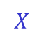
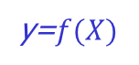
Plain CNN
Let us suppose we have an input X to an initial deep model which outputs f(X)
Let us suppose that the underlying map we want to learn is H(X)
Hypothesis: Multiple non linear layers can approximate complex functions such H(X)
$$X$$
Initial deep
model
y=$f(X)$
Genc Hoxha
Lab session 1
Notes:
Da questa slide fino alla slide numero 30 scrivo alla lavagna
Hypothesis. Multiple non linear layers can approximate complex functions, such it can be H(X.) the desired map. However, learning this mapping is not trivial at all and in most of the time we are going to learn H(X)’ which wish to be as close as possible to H(X). Adding more layers instead of bringing us closer to the desired map, it is going to push us further away from the desired mapping as we saw previously. This means that deep models have a really hard time on learning the identity map that brings us to have f(X) as output instead of f’(f(X))

Slide 42
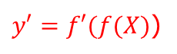
Plain CNN
We extend the model by adding some layers
If f(X) is a already a good approximation of H(X) then f’(f(X)) should be at least as good as f(X)
It means that the added layers should at least be able to learn the identity function I in order to have as output f(X)
$$X$$
Initial deep
model
y=$f(X)$
$y′=f′(f(X)$)
Stacked layers
Genc Hoxha
Lab session 1
Notes:
Hypothesis. Multiple non linear layers can approximate complex functions, such it can be H(X.) the desired map. However, learning this mapping is not trivial at all and in most of the time we are going to learn f(X)’ which wish to be as close as possible to H(X). Adding more layers instead of bringing us closer to the desired map, it is going to push us further away from the desired mapping as we saw previously. This means that deep models have a really hard time on learning the identity map, Adding more layers instead of bringing us closer to the desired map, it is going to push us further away from the desired mapping as we saw previously. This means that deep models have a really hard time on learning the identity map that brings us to have f(X) as output instead of f’(f(X))

Slide 43
Residual Learning
It turns out that it is difficult for neural network to learn I
If multiple non linear layers are able to asymptotically approximate H(X)
They can also approximate the residual R(X): R(X) = H(X) – f(X)
Then H(X) can be obtained as:
H(X) = R(X) + f(X)
Genc Hoxha
Lab session 1
Notes:
Hypothesis. Multiple non linear layers can approximate complex functions, such it can be H(X.) the desired map. However, learning this mapping is not trivial at all and in most of the time we are going to learn H(X)’ which wish to be as close as possible to H(X). Adding more layers instead of bringing us closer to the desired map, it is going to push us further away from the desired mapping as we saw previously. This means that deep models have a really hard time on learning the identity map.
Adding more layers instead of bringing us closer to the desired map, it is going to push us further away from the desired mapping as we saw previously. This means that deep models have a really hard time on learning the identity map that brings us to have f(X) as output instead of f’(f(X))

Slide 44

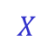
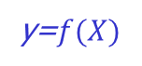
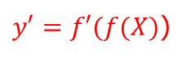
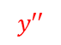
Residual Learning
Skip connection: connection that skip some layers
Through skip connection we get:
y’’=f’(f(X)) + f(X)
f’(f(X)) becomes the residual mapping to be learned
If f’(f(X)) tends to zero, the stacked layers will learn the identity function I
Skip Connection
ReLu
$$X$$
Initial deep
model
y=$f(X)$
$y′=f′(f(X)$)
$$y′′$$
Stacked layers
$$+$$
Genc Hoxha
Lab session 1
Notes:
Hypothesis. Multiple non linear layers can approximate complex functions, such it can be H(X.) the desired map. However, learning this mapping is not trivial at all and in most of the time we are going to learn f(X)’ which wish to be as close as possible to H(X). Adding more layers instead of bringing us closer to the desired map, it is going to push us further away from the desired mapping as we saw previously. This means that deep models have a really hard time on learning the indentity map
Adding more layers instead of bringing us closer to the desired map, it is going to push us further away from the desired mapping as we saw previously. This means that deep models have a really hard time on learning the identity map that brings us to have f(X) as output instead of f’(f(X))

Slide 45
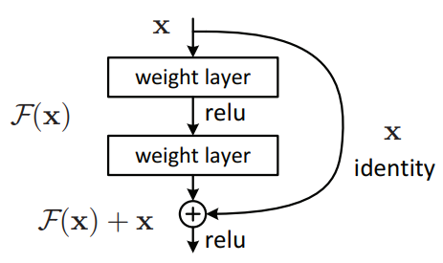
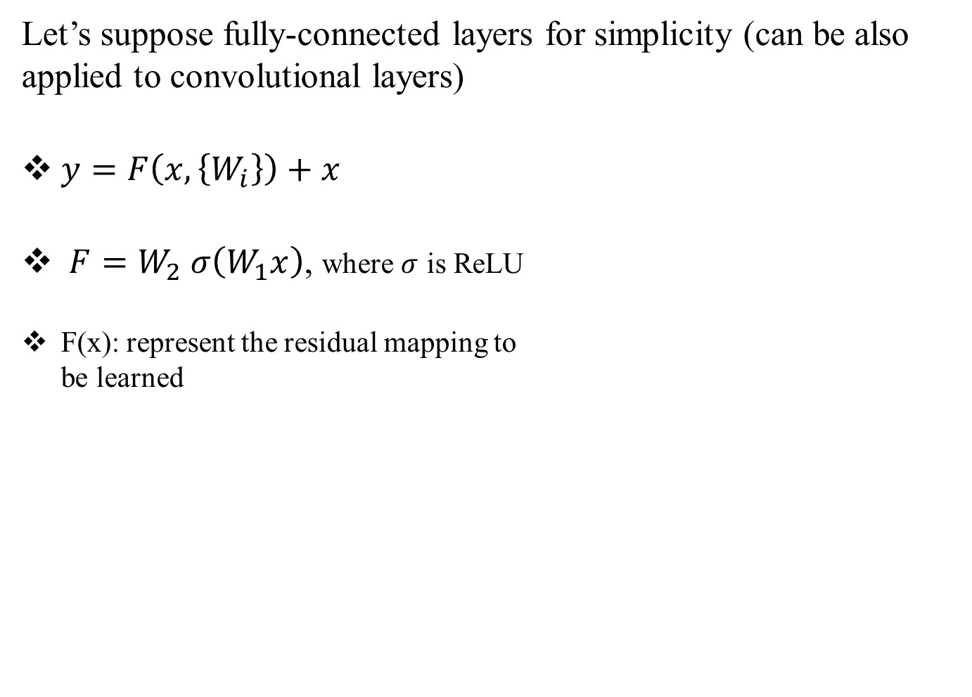
ResNet 50: Residual Block
Let’s suppose fully-connected layers for simplicity (can be also applied to convolutional layers)
$y=F\left(x,\left\{W_{i}\right\}\right)+x$
$F=W_{2} σ\left(W_{1}x\right)$, where $σ$ is ReLU
F(x): represent the residual mapping to be learned
Residual block
Genc Hoxha
Lab session 1
Notes:
Hypothesis. Multiple non linear layers can approximate complex functions, such it can be H(X.) the desired map. However, learning this mapping is not trivial at all and in most of the time we are going to learn H(X)’ which wish to be as close as possible to H(X). Adding more layers instead of bringing us closer to the desired map, it is going to push us further away from the desired mapping as we saw previously. This means that deep models have a really hard time on learning the indentity map, which in this case is the X
Adding more layers instead of bringing us closer to the desired map, it is going to push us further away from the desired mapping as we saw previously. This means that deep models have a really hard time on learning the identity map that brings us to have f(X) as output instead of f’(f(X))

Slide 46
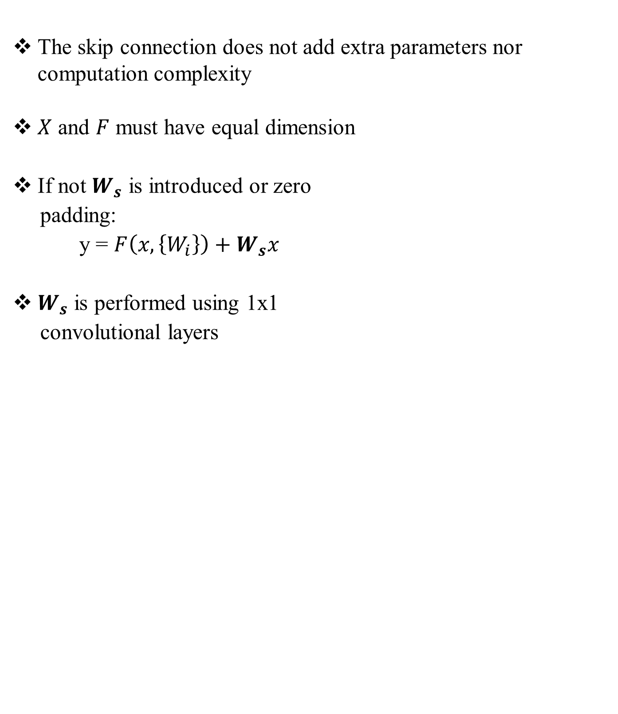

ResNet 50: Residual Block
The skip connection does not add extra parameters nor computation complexity
$X$ and $F$ must have equal dimension
If not $W_{s}$ is introduced or zero
padding:
y = $F\left(x,\left\{W_{i}\right\}\right)+W_{s}x$
$W_{s}$ is performed using 1x1
convolutional layers
Residual block
$y=F\left(x,\left\{W_{i}\right\}\right)+x$
$F=W_{2} σ\left(W_{1}x\right)$
Genc Hoxha
Lab session 1
Notes:
Hypothesis. Multiple non linear layers can approximate complex functions, such it can be H(X.) the desired map. However, learning this mapping is not trivial at all and in most of the time we are going to learn H(X)’ which wish to be as close as possible to H(X). Adding more layers instead of bringing us closer to the desired map, it is going to push us further away from the desired mapping as we saw previously. This means that deep models have a really hard time on learning the indentity map, which in this case is the X
Adding more layers instead of bringing us closer to the desired map, it is going to push us further away from the desired mapping as we saw previously. This means that deep models have a really hard time on learning the identity map that brings us to have f(X) as output instead of f’(f(X))
Potrei scriver alla lavagna cosa sono 1x1 conv layers

Slide 47
ResNet 50 Architecture
He, Kaiming, et al. "Deep residual learning for image recognition." Proceedings of the IEEE conference on computer vision and pattern recognition. 2016.
47
Genc Hoxha
Lab session 1
Notes:
Resnet is composed of skip connection that takes output of one layer and feed it to the subsequent layer
If for instance in the subsequent layer, the parameters of our network because of backpropagation will explode or vanish we will still remain with the identity function and for the network is something trivial to learn, meaning that adding layers is not going to degrade our performance.
If the input and output different dimension, you can multiply the previous output with a projection matrix that at the end the dimension will match or we can just add zero padding in order to make matrices to match their dimensions. The projection matrix is performed by 1x1 convolutional layer.
Potrei scrivere alla lavagna l’operazione di conv 1x1

Slide 48

ResNet
Training and testing error on CIFAR-10 dataset
Dashed lines: training error
Bold lines: testing error
He, Kaiming, et al. "Deep residual learning for image recognition." Proceedings of the IEEE conference on computer vision and pattern recognition. 2016.
48
Genc Hoxha
Lab session 1

Slide 49
Transfer Learning with ResNet50
Delete the last fully
connected layer
49
Genc Hoxha
Lab session 1
Notes:
Delete the last fully connected layer

Slide 50
Transfer Learning with ResNet50
Freeze all the layers
Global average Pooling
Add a new network head
and train the network
1 fc, sigmoid
50
Genc Hoxha
Lab session 1
Notes:
Add a new network head to the network. Global average pooling reduces the network to have 1x1xd dimensions by simply doing the avg of each filter map.
Potrei fare anche qui il disegno del global avg pooling

Slide 51
Fine Tuning ResNet50
Unfreeze all the layers
and retrain the network
with a very low learning
rate
Global average Pooling
1 fc, sigmoid
51
Genc Hoxha
Lab session 1
Notes:
Delete the last fully connected layer
Freeze all the layers from the last conv, add the new network head and train the model to convergence.
Unfreeze all the layers and retrain the network with a very low learning rate for a few epochs. The mode is going to be in test mode, so the statistics of the data will remain the same. This means that the batch normalization layers inside won't update their batch statistics.

Slide 52
First part of the code:
Building and training a CNN
Note: As explained in the first lesson, python is used both in academia and companies. It is very easy to find part of the code of your interest online. In the following you might find parts of the code taken from the web and afterwards modified or adopted for teaching purposes.
Genc Hoxha
Lab session 1

Slide 53


Useful libraries and Dataset
Retrieve hardware (GPU/CPU)
Download
and unzip
the dataset
Delete the corrupted files from the dataset
Genc Hoxha
Lab session 1

Slide 54

Data Generator
Parameter set up
Performs processing and data augmentation on the ‘fly’: rescaling and data augmentation. Three types of data augmentation: Horizontal and vertical flips and rotation. Applied only to training data
Only rescaling is applied
on validation data
Get data from folders and arranges them in mini-batches. Specify the image target dimension (fixed), mini-batch and binary mode for binary classification. Seed is used to have the same fixed random data shuffling and transformation
Genc Hoxha
Lab session 1

Slide 55

Data Generator
Get data from folders and arranges them in mini-batches. Specify the image target dimension (fixed), mini-batch and binary mode for binary classification. Seed is used to have the same fixed random data shuffling and transformation
Get a mini-batch from training and retrieve images along with
their labels
Function that converts the selected mini-batch items from binary to their respective labels for later visualization
Genc Hoxha
Lab session 1

Slide 56

Model Construction
Libraries and the function needed to visualize the data on the mini-batch
Input shape of our neural network
To build our neural network model we use the
sequential model which allows to stack the layers
that compose the neural network model one by
one
Genc Hoxha
Lab session 1

Slide 57

Model Training
Model checkpoint: used in conjunction with model.fit to save a model or its weights. We monitor the accuracy of the validation set and save only the best models
Mini-batch gradient descent optimizers with its default parameters (learning rate: 0.01 and momentum=0.0)
Model configuration for training. Loss: binary cross entropy
Optimizer: Mini-batch gradient descent
Metric: accuracy
Prints the model summary (layers, input and output of each layers and the number of parameters of the model)
Number of epochs
Training the model
Genc Hoxha
Lab session 1

Slide 58

Model Evaluation
Plots training and validation accuracies over the 20 epochs of training
Plots training and validation losses over the 20 epochs of training
Model loading: loads model’s weights
Calculates the model accuracy on the validation data
Note that we set the mini-batch size to 1 and we do
not shuffle the validation samples anymore. This is
done to have a correspondence between samples’
ground truth labels and predicted labels
Calculates the prediction of each sample and saves it in an array. We save in an array also the ground truth labels
Genc Hoxha
Lab session 1

Slide 59

Sample Prediction Visualization
Importing some useful libraries for data visualization and random number generator
Converting the predicted and ground truth labels into their respective category
Showing some random samples along with
the predicted and ground truth categories
Genc Hoxha
Lab session 1

Slide 60

Confusion Matrix
Import confusion matrix from sklearn
Pass the ground truth labels and the predictions into the confusion matrix
Create a list of labels
Function that plots the confusion
matrix
Genc Hoxha
Lab session 1

Slide 61

Confusion Matrix
Function that plots the confusion matrix (continues from previous slide)
Set printing options
Plot the confusion
matrix
Genc Hoxha
Lab session 1

Slide 62

Evaluation Metrics
Import the different metrics
Calculate and print the
different metrics
Genc Hoxha
Lab session 1

Slide 63
Second part of the code:
Transfer learning and fine-tuning ResNet 50
Note: As explained in the first lesson, python is used both in academia and companies. It is very easy to find part of the code of your interest online. In the following you might find parts of the code taken from the web and afterwards modified or adopted for teaching purposes.
Genc Hoxha
Lab session 1

Slide 64
Useful libraries and Dataset
Retrieve hardware (GPU/CPU)
Download
and unzip
the dataset
Delete the corrupted files from the dataset
Genc Hoxha
Lab session 1

Slide 65

Data Generator
Parameter set up
Only rescaling is applied on validation data
Get data from folders and arranges them in mini-batches. No need to specify the image target dimension. Specify mini-batch and binary mode for binary classification. Seed is used to have the same fixed random data shuffling and transformation
Genc Hoxha
Lab session 1

Slide 66

Transfer Learning with ResNet 50
Download the pertained ResNet 50 (on imagenet) weights without the classification layer and set every layer to non-trainable
Check whether all the layers are set to non-trainable
Create the new network head
Define the input and the output of the model
Check whether all the layers are set to non-trainable except for the network head
Genc Hoxha
Lab session 1

Slide 67

Model Training
Model checkpoint: used in conjunction with model.fit to save a model or its weights. We monitor the accuracy of the validation set and save only the best models
Mini-batch gradient descent optimizers with its default parameters (learning rate: 0.01 and momentum=0.0)
Model configuration for training. Loss: binary cross entropy
Optimizer: Mini-batch gradient descent
Metric: accuracy
Training the model
Genc Hoxha
Lab session 1

Slide 68

Fine-Tuning
Unfreeze the layers
Check whether all the layers are trainable
Set a low learning rate
Retrain the model
Genc Hoxha
Lab session 1

Slide 69

Model Evaluation
Load the weights of the best model
Calculates the model accuracy on the validation data.
Note that we set the mini-batch size to 1 and we do not shuffle the validation samples anymore. This is done to have a correspondence between samples’ ground truth labels and predicted labels
Calculates the prediction of each sample and saves it in an array. Note that the predictions here are probabilities.
We save in an array also the ground truth labels
Convert probabilities to the corresponding category
Genc Hoxha
Lab session 1

Slide 70

Confusion Matrix
Import confusion matrix from sklearn
Pass the ground truth labels and the predictions into the confusion matrix
Create a list of labels
Function that plots the confusion
matrix
Genc Hoxha
Lab session 1

Slide 71

Confusion Matrix
Function that plots the confusion matrix (continues from previous slide)
Set printing options
Plot the confusion
matrix
Genc Hoxha
Lab session 1

Slide 72

Evaluation Metrics
Import the different metrics
Calculate and print the
different metrics
Genc Hoxha
Lab session 1

